Slide 1
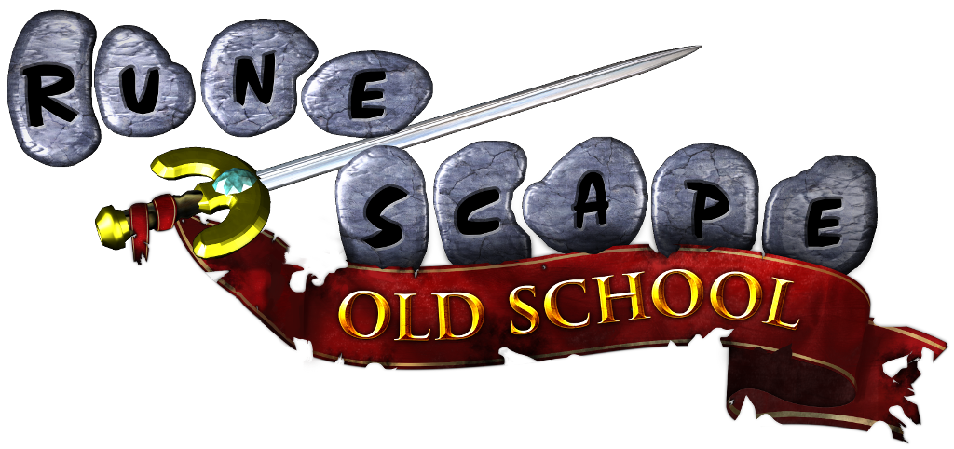
Analyzing Item Values by Type
In OldSchool Runescape
Chandler Mateka

Slide 2

Project Goals
Seek out correlations between an item’s stats/metadata and its market value
Create visuals to assist
Key metadata values used
Item type
Strength bonus
Link to head slot table

Slide 3
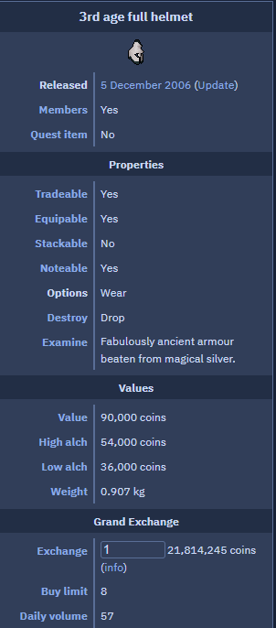
Data Gathered
Far more data was gathered than necessary to allow for future exploration.
For all armour, weapons, and other equipment in-game:
Offensive and defensive bonuses for different combat styles
Current market value in player-run economy
Item type (helmet, weapon, boots, etc.)
Value in other forms such as alchemy
Categorical data such as whether it is available to all playersor only those with a subscription
Brief item description

Slide 4

Methods Used
Data collection
RobotFileParser
BeautifulSoup
Data management and visualization
Pandas
MatPlotLib

Slide 5

Challenges & Predictions
Expected challenges
Separating armor, weapons, and subtypes
Creating models
Creating good visualizations
Predictions
Item stats alone will not be enough
Huge exponential jumps

Slide 6
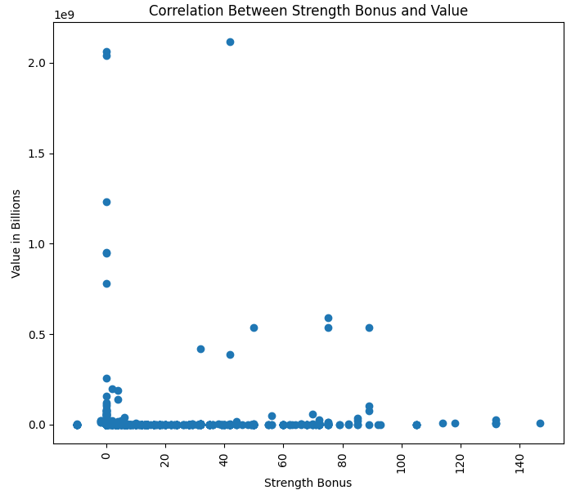
Strength Bonus
One early idea was to seek out a correlation between an items strength bonus and its value. In my experience with the game, strength bonus is generally regarded as one of the highest valued stats for an item, since it provides the strongest weighting towards damage output. While the plot shows mostly insignificant points, there is a group of points that tend towards my hypothesis that higher strength may contribute to higher value.

Slide 7
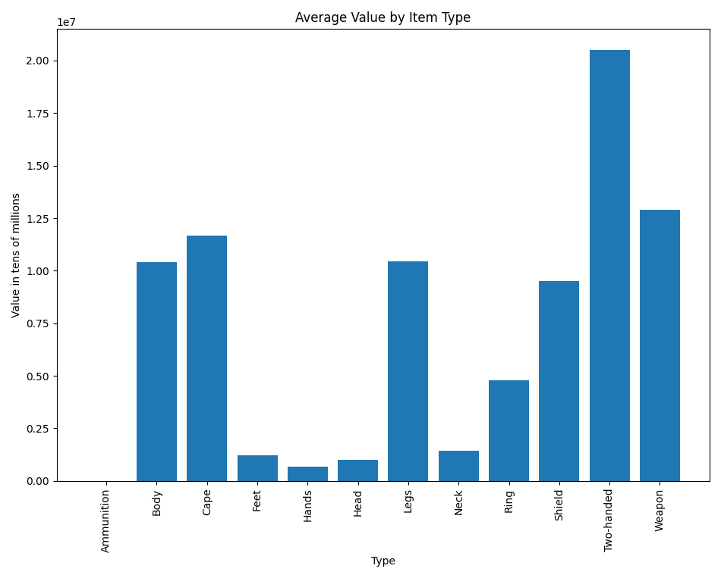
Average Value by Type
As a step towards less biased results, I analyzed the average value of each type of item. Feet, Hand, Head, and Neck items have very low means, which makes sense as they typically have lower stat bonuses than types like body armor or weapons. The mean value of two-handed weapons rises high above, perhaps due to their very high stat bonuses and damage output compared to other types.

Slide 8
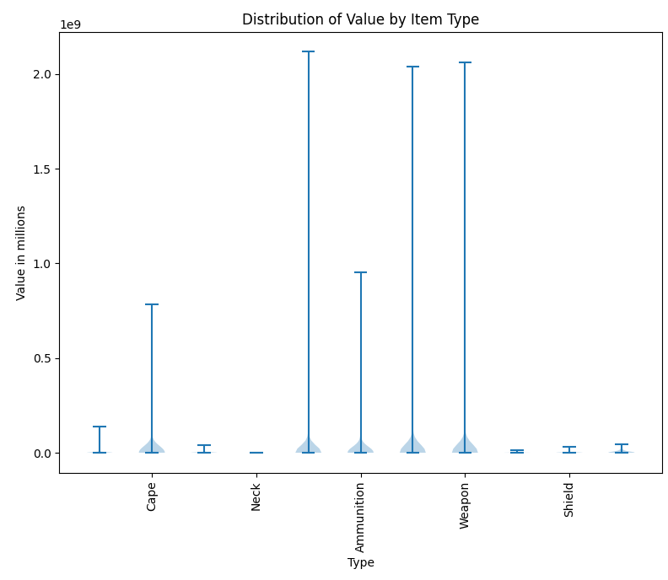
Value Distribution by Type
To dive deeper into this path, I created a similar plot to the previous bar plot. This time as a violin plot to gain some insight into the range of outliers and distribution of the majority of the values. Unfortunately I could not get all of the x-ticks to show but, the 3 highest outlier Types in the center of the plot are Body, Two-Handed, and Weapon. These outliers bring credibility to body armor and weapons being the most valuable types.

Slide 9

Conclusions
The highest valued items are of the types Body, Two-Handed, and Weapon.
Item that give higher stat bonuses in general such as body armor types and weapons tend to have higher values.
A higher strength bonus may contribute to higher value, but further research is required.

Slide 10

Future Work
Search for correlations across EVERY metadata point for every item
Create more, higher quality plots
Ask players what they think makes an item valuable for ideas of where to look deeper.
Work towards a machine learning approach to create a model to approximate value based on a item’s metadata

